Slide 1
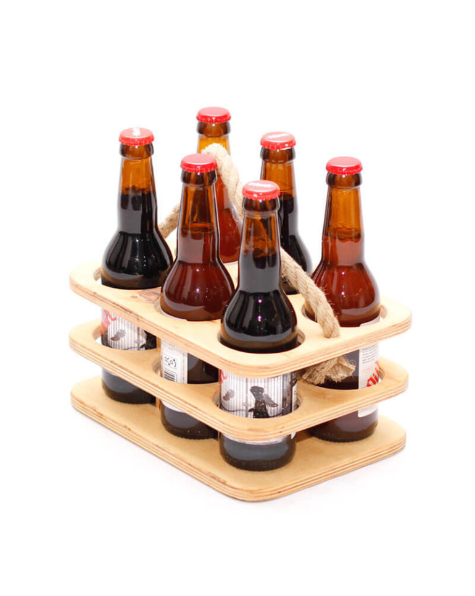
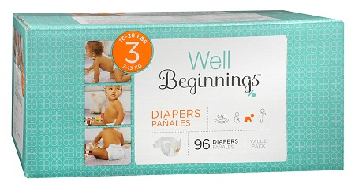
Recommendation Systems
Eindhoven Data Science
Eindhoven Data Science

Slide 2
Overview
Part I
Introduction
Types of recommender systems
Cold start
Part II
Task Description
Code example
Eindhoven Data Science Recommendation Systems

Slide 3







Introduction
Eindhoven Data Science Recommendation Systems

Slide 4

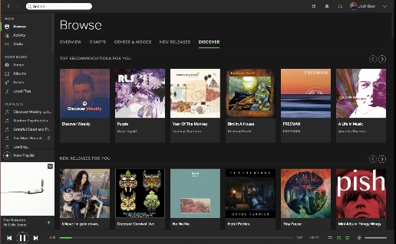
Examples
Eindhoven Data Science Recommendation Systems

Slide 5
Collaborative recommendation
Identify users who share the same interests.
Key idea
If users have similar history they might be interested in the same topics in the future.
Eindhoven Data Science Recommendation Systems

Slide 6
Content-based recommendation
Identify items that have similar features.
Key idea
Find similarities between different items based on the set of features.
Eindhoven Data Science Recommendation Systems

Slide 7
Knowledge-based recommendation
Give information to new users with no or little history
Key idea
Interact with user that has blank or new profile for providing recommendations.
Eindhoven Data Science Recommendation Systems

Slide 8
Cold start
When no or little information can be derived for a new user, it is very difficult to provide meaningful recommendations.
Eindhoven Data Science Recommendation Systems

Slide 9
Practical assignment
Make movie recommendations based
on MovieLens 100K data set.
Eindhoven Data Science Recommendation Systems

Slide 10
Task description
Information about data.
Eindhoven Data Science Recommendation Systems

Slide 11
Getting started
Information about code.
Eindhoven Data Science Recommendation Systems

Slide 12
Eindhoven Data Science
Questions?
The password for Wi-Fi is abc.
Eindhoven Data Science Recommendation Systems

